Slide 1
ICTIS 2023
PAPER PRESENTATION
On
PLANT AND WEED SEEDLINGS CLASSIFICATION
USING DEEP LEARNING TECHNIQUES
By Sk. Farheen Sk. Ashrita Parvin U. Rajarajeswari
Y. Nikhila
Paper Id - 222

Slide 2
Table Of Contents
Abstract
Objectives
Existing System
Proposed System
Methodology
Results
Conclusion
Output

Slide 3
Abstract
Agriculture is very important to human existence and remains a key driver of many economies worldwide, especially in underdeveloped and developing economies.
Due to the increasing world population and the challenges imposed by climate modifications, there is a need to increase plant production while reducing costs.
Weed management has a vital role in this scenario. One of the key tasks is to identify the weeds after a few days of plant germination, which helps the farmers perform early-stage weed management to reduce the adverse impacts on crop growth.
The detection of plant diseases is also based on leaf detection.

Slide 4
Objectives
To identify the plant species.
To classify the seedlings of crop and weed species.

Slide 5
Existing System
Existing models that classifies the plant seedlings
- CNN model
- Machine Learning model developed using SVM
These existing models did not give high accuracy.

Slide 6
Proposed System
Several classification techniques are proposed in this project to forecast the plant sort outcome from the test data, which include
- CNN model. (Convolutional Neural Networks)
- ResNet50 models. (Residual Networks)
- Xception model.

Slide 7
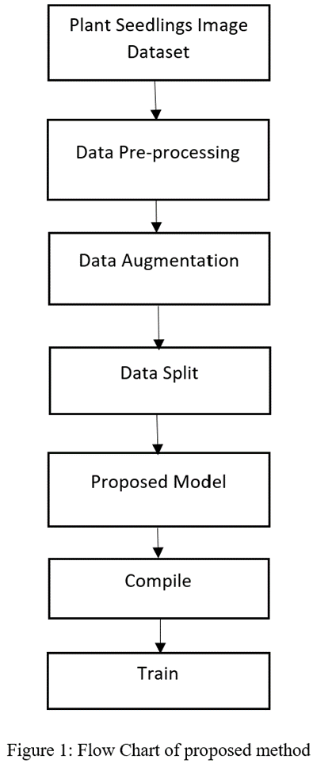
Methodology

Slide 8
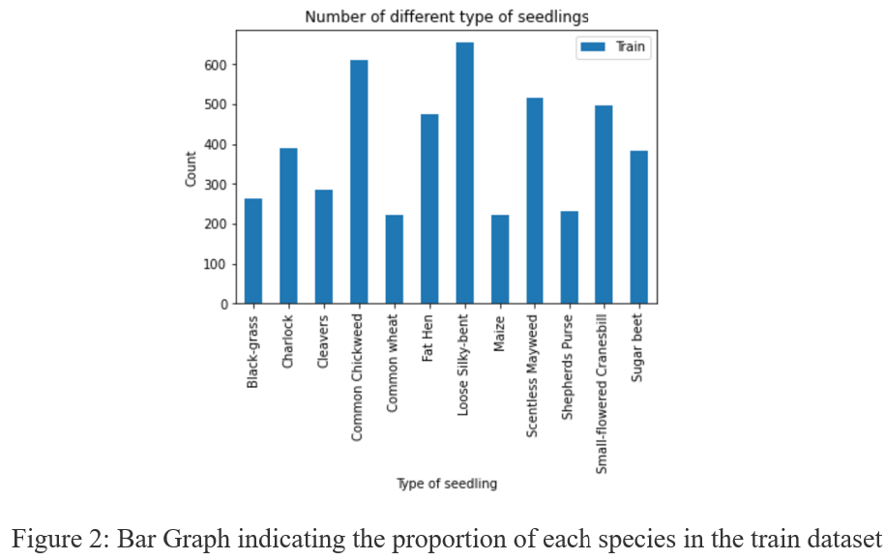
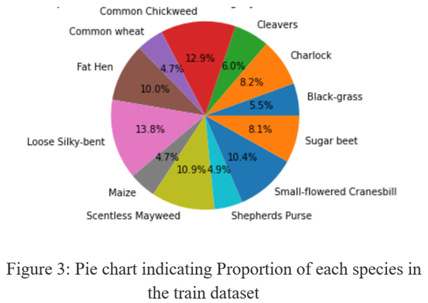
Dataset Description
A publicly available dataset from Kaggle was used, containing approximately 5544 images, out of which 794 images represented the test set and 4750 images represented the training set. These images depicted distinctive plants from 12 different plant species.

Slide 9
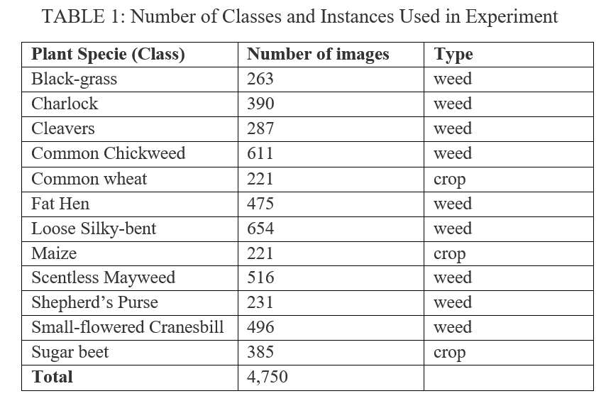
Dataset

Slide 10
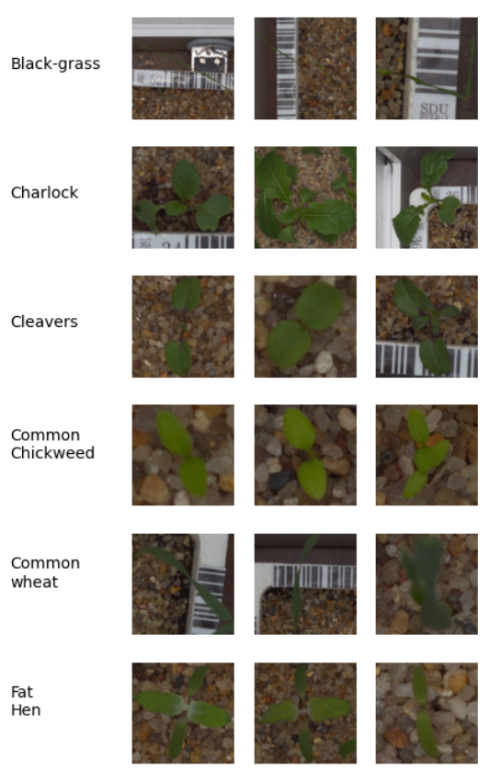
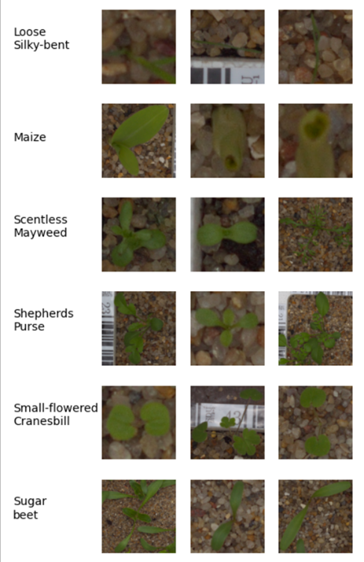
Dataset
Figure 4: Some of the plant seedling images.

Slide 11
Data Pre-processing
The images are resized to 224 x 224 pixels and 300 x 300 pixels. Pixel values are normalised as per the model, which gives a better training result.

Slide 12
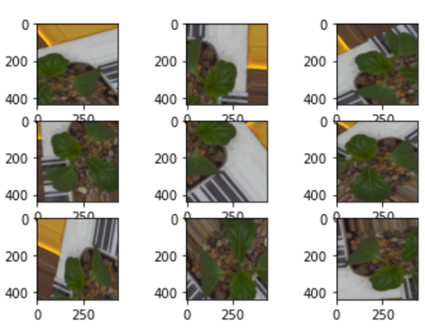
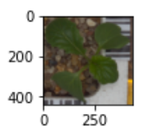
Data Augmentation
A data augmentation technique is performed to reduce over-fitting during training. This procedure is very helpful when dealing with an unbalanced dataset. The augmentation methods applied are: rotation by 180 degrees; zooming in a range of 0–30%; width-shift and height-shift in a range of 0–30%; horizontal and vertical flips.
Figure 5: Actual image of Charlock
Figure 6: Images generated after performing augmentation on figure 5

Slide 13
Data Split
The training set and test set are already present in the dataset.
The training set is divided into a 9:1 ratio, where 90% is used for training and 10% for validation.
After data split, the training, validation, and test sets contain 4279, 471, and 794 images, respectively, belonging to 12 classes.

Slide 14
Model Building
In this project, several models (classifiers) are employed:
- self-built CNN model
- ResNet-50 models
- Xception model

Slide 15
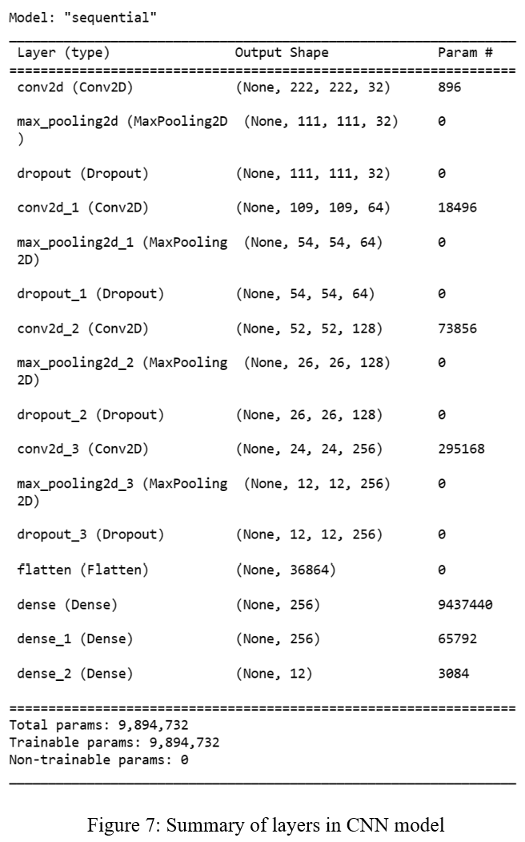
Convolutional Neural Network
Convolutional Neural Network (CNN) works better with images since it can discover features by itself. A CNN employs 2D convolutional layers and integrates input data with learned characteristics, making it an excellent architecture for processing 2D data, such as photos. A convolutional neural network consists of an input layer, hidden layers, and an output layer.

Slide 16
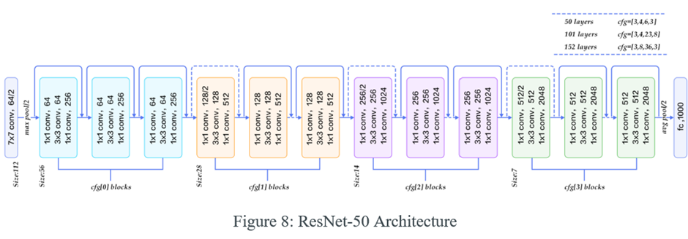
ResNet-50
The residual network is known as ResNet. ResNet has numerous variations that use the same idea but have various numbers of layers.
Resnet50 is the name given to the version that supports 50 neural network layers. It has forty-eight convolution layers, one average pool layer, and one MaxPool layer. It’s a common ResNet model.

Slide 17
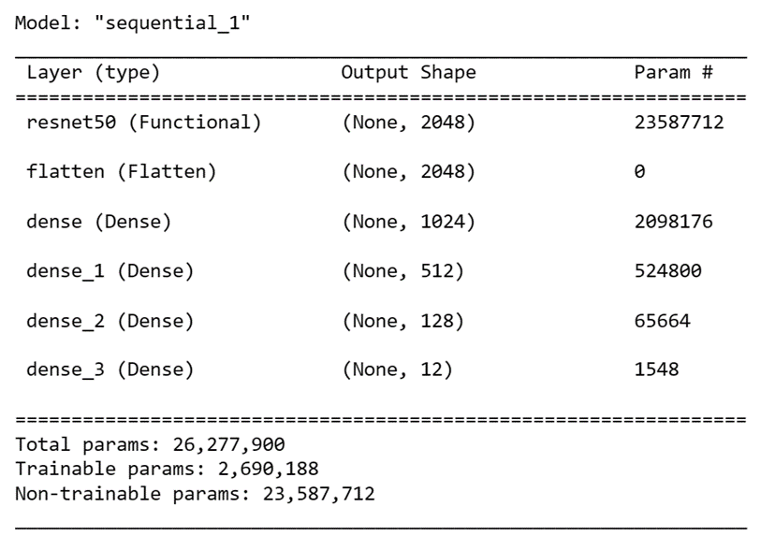
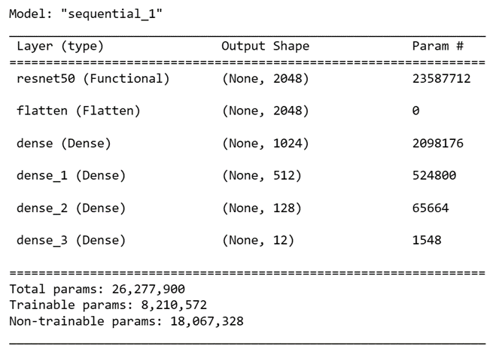
Modified ResNet-50
2. Fine-tuning the ResNet50:
1. ResNet-50 as feature extractor:
Figure 9: Summary of layers in Resnet50 as feature extractor model.
Figure 10: Summary of layers in ResNet-50 finely tuned model.

Slide 18
Xception
Xception, short for "extreme inception," is a concept that takes the principles of Inception to an extreme. In Inception, the initial input was compressed using 1x1 convolutions, and the depth space was then created from each of the input spaces using various types of filters. This step is simply reversed by Xception.
Xception is a convolutional neural network that is 71 layers deep.
Xception architecture is a linear stack of depthwise separable convolution layers.
The data first goes through the entry flow, then through the middle flow which is repeated eight times, and finally through the exit flow.
Note that all Convolution and Separable Convolution layers are followed by batch normalization.

Slide 19
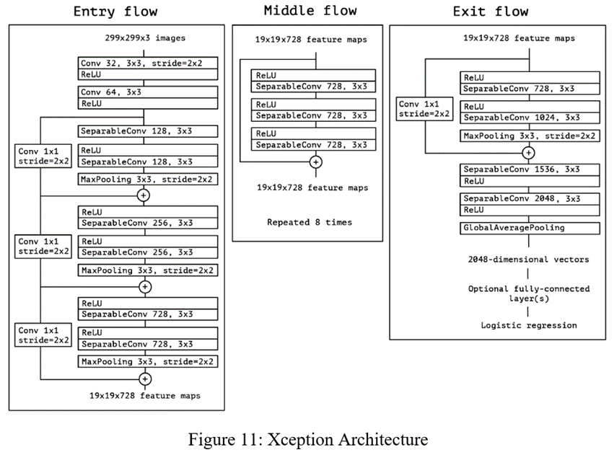
Xception

Slide 20
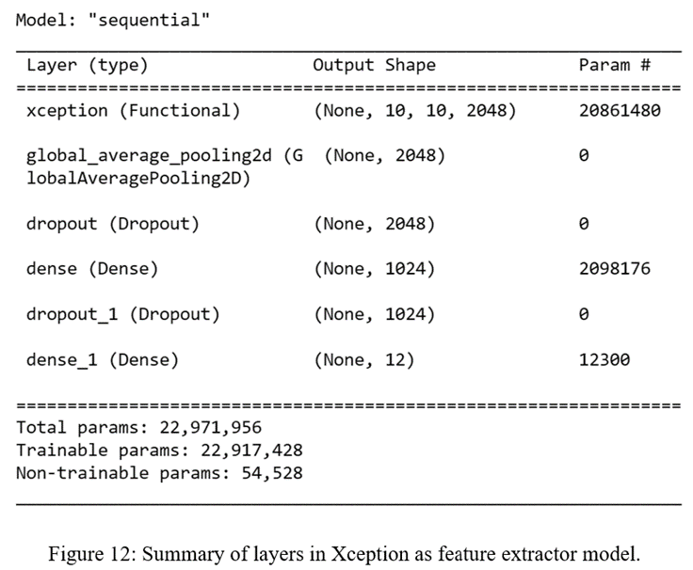
Modified Xception
Xception as feature extractor:

Slide 21
Compiling & Training the model
After building the model, it is executed using the training and validation datasets. The models are trained for 100 epochs using an early stopping method to monitor the validation accuracy and avoid overtraining. The Adam optimizer and categorical cross-entropy loss function are used, along with a batch size of 16. After compilation and training, the models are evaluated.

Slide 22
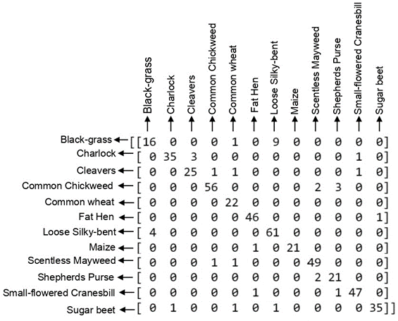

Results
(i) Confusion Matrix of self-built CNN model with 224x224 pixel size
(ii) Confusion Matrix of ResNet-50 with 224x224 pixel size

Slide 23


Results
(iii) Confusion Matrix of Resnet-50 with 300x300 pixel size
(iv) Confusion Matrix of finely tuned ResNet-50 (Last 15 layers trainable)+ three dense layers with 224x224 pixel size

Slide 24


Results
(v) Confusion Matrix of finely tuned ResNet-50 (Last 15 layers trainable) + three dense layers with 300x300 pixel size
(vi) Confusion Matrix of Xception with 300x300 pixel size

Slide 25
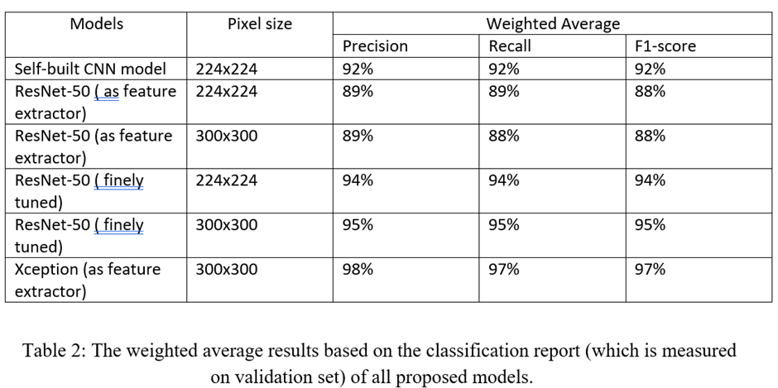
Comparing Results

Slide 26
Comparing Results
Table 3: Accuracy of all proposed models

Slide 27
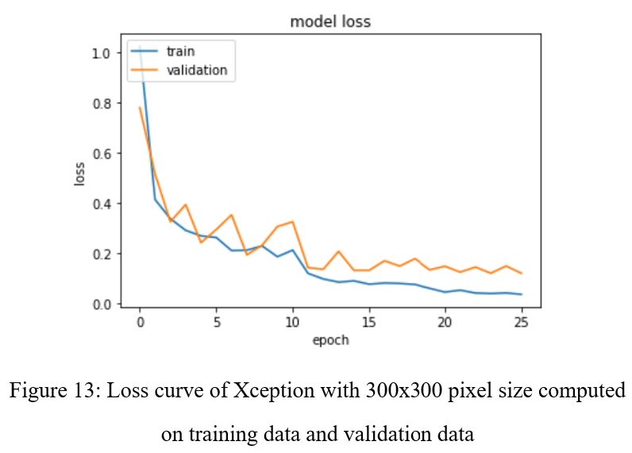
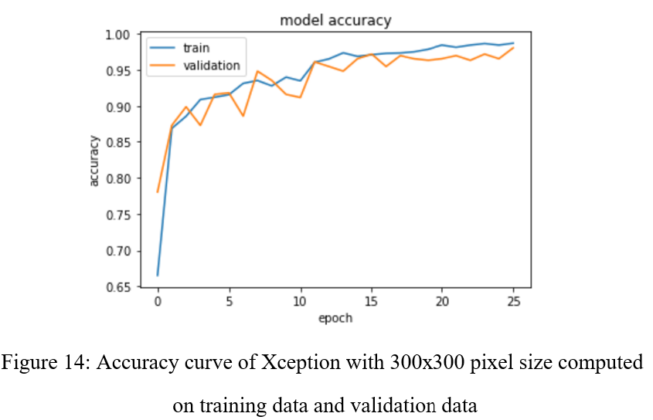
Results

Slide 28
Conclusion
Four CNN architectures are used in this work to accurately distinguish plants and weeds: self-built CNN, ResNet-50 as a feature extractor, finely tuned ResNet-50, and Xception as feature extractor models.
Initially, self-built CNN model was employed for categorization, as demonstrated, but it performed poorly.
The ResNet model is then utilised to increase the accuracy; for 224x224 and 300x300 pixel sizes, respectively, the finely tuned Resnet-50 provided a better accuracy of 94% and 95%.
Xception model is used as a feature extractor to improve accuracy. It yielded the highest accuracy of 97%. Farmers could use this model to automatically classify weeds and seedlings.

Slide 29
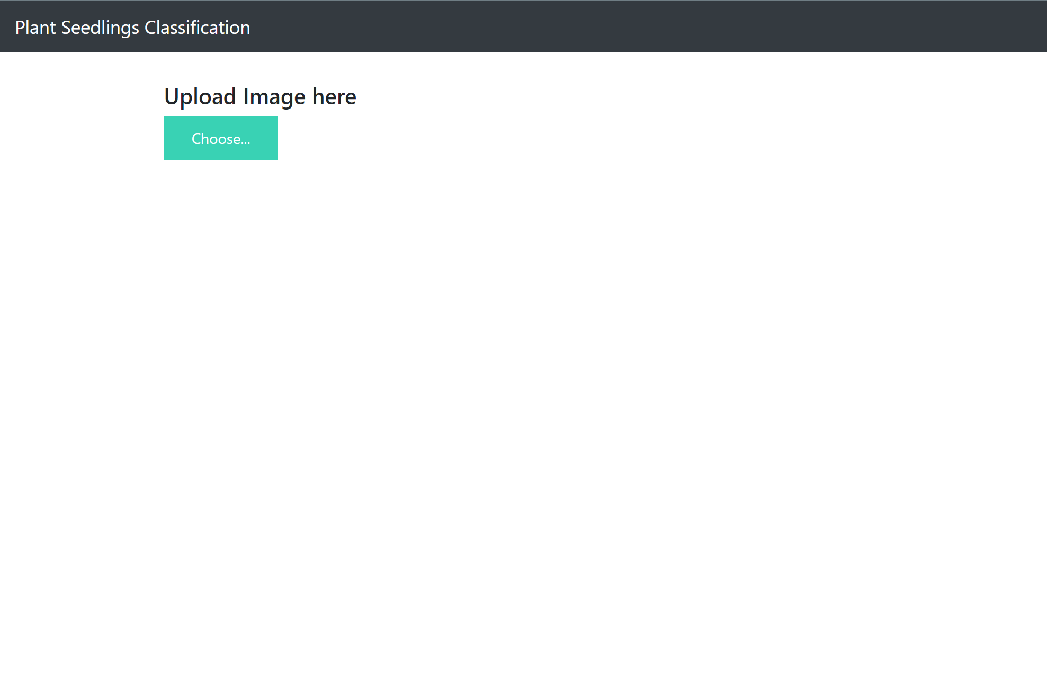
Output

Slide 30
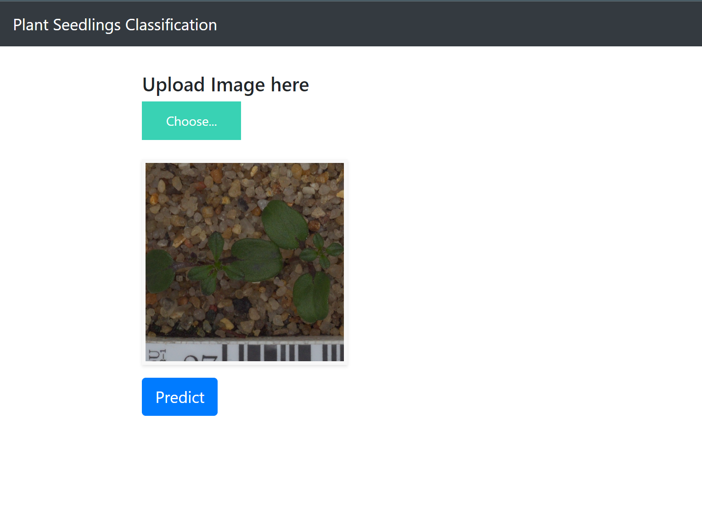
Output

Slide 31
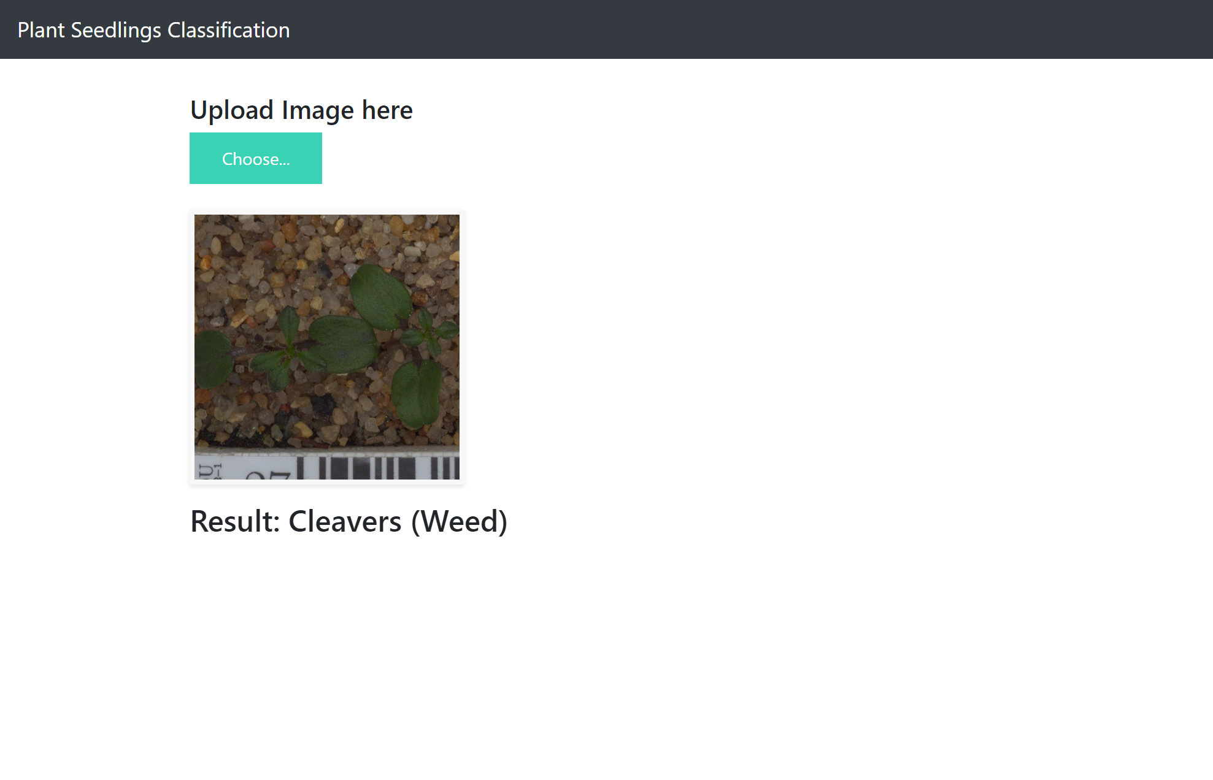
Output

Slide 32
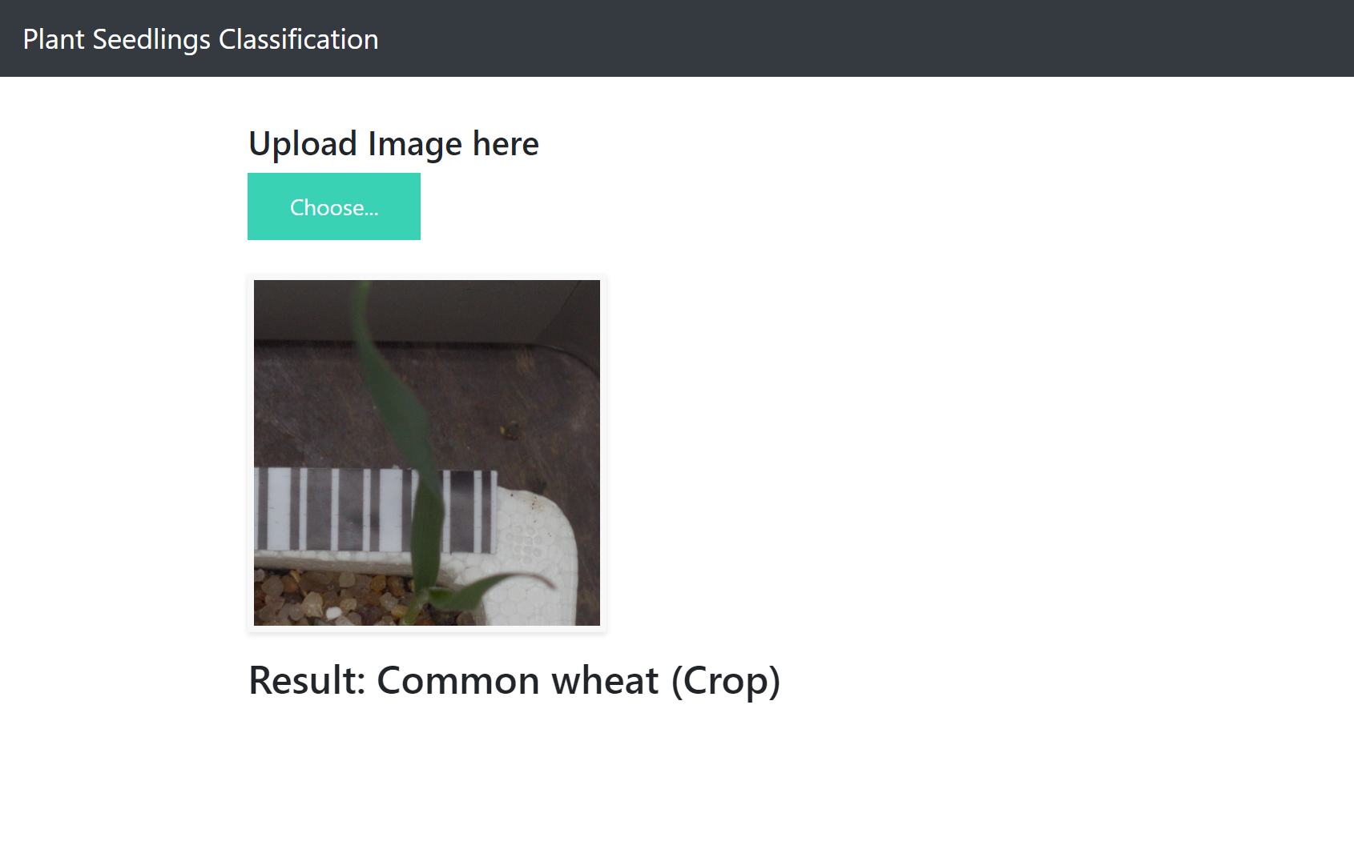
Output

Slide 33
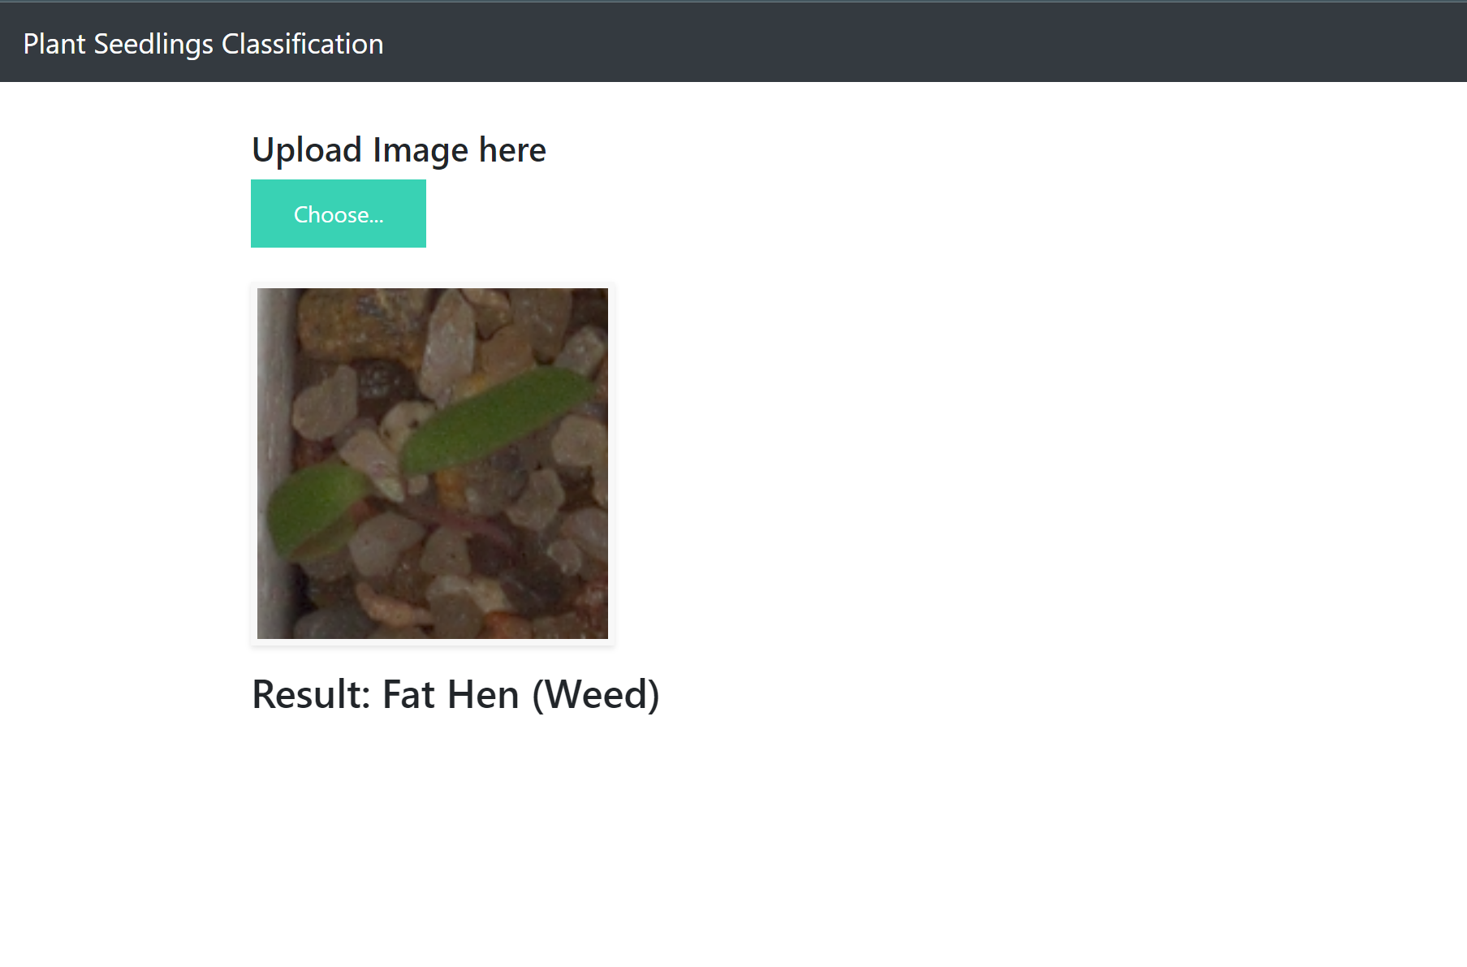
Output

Slide 34
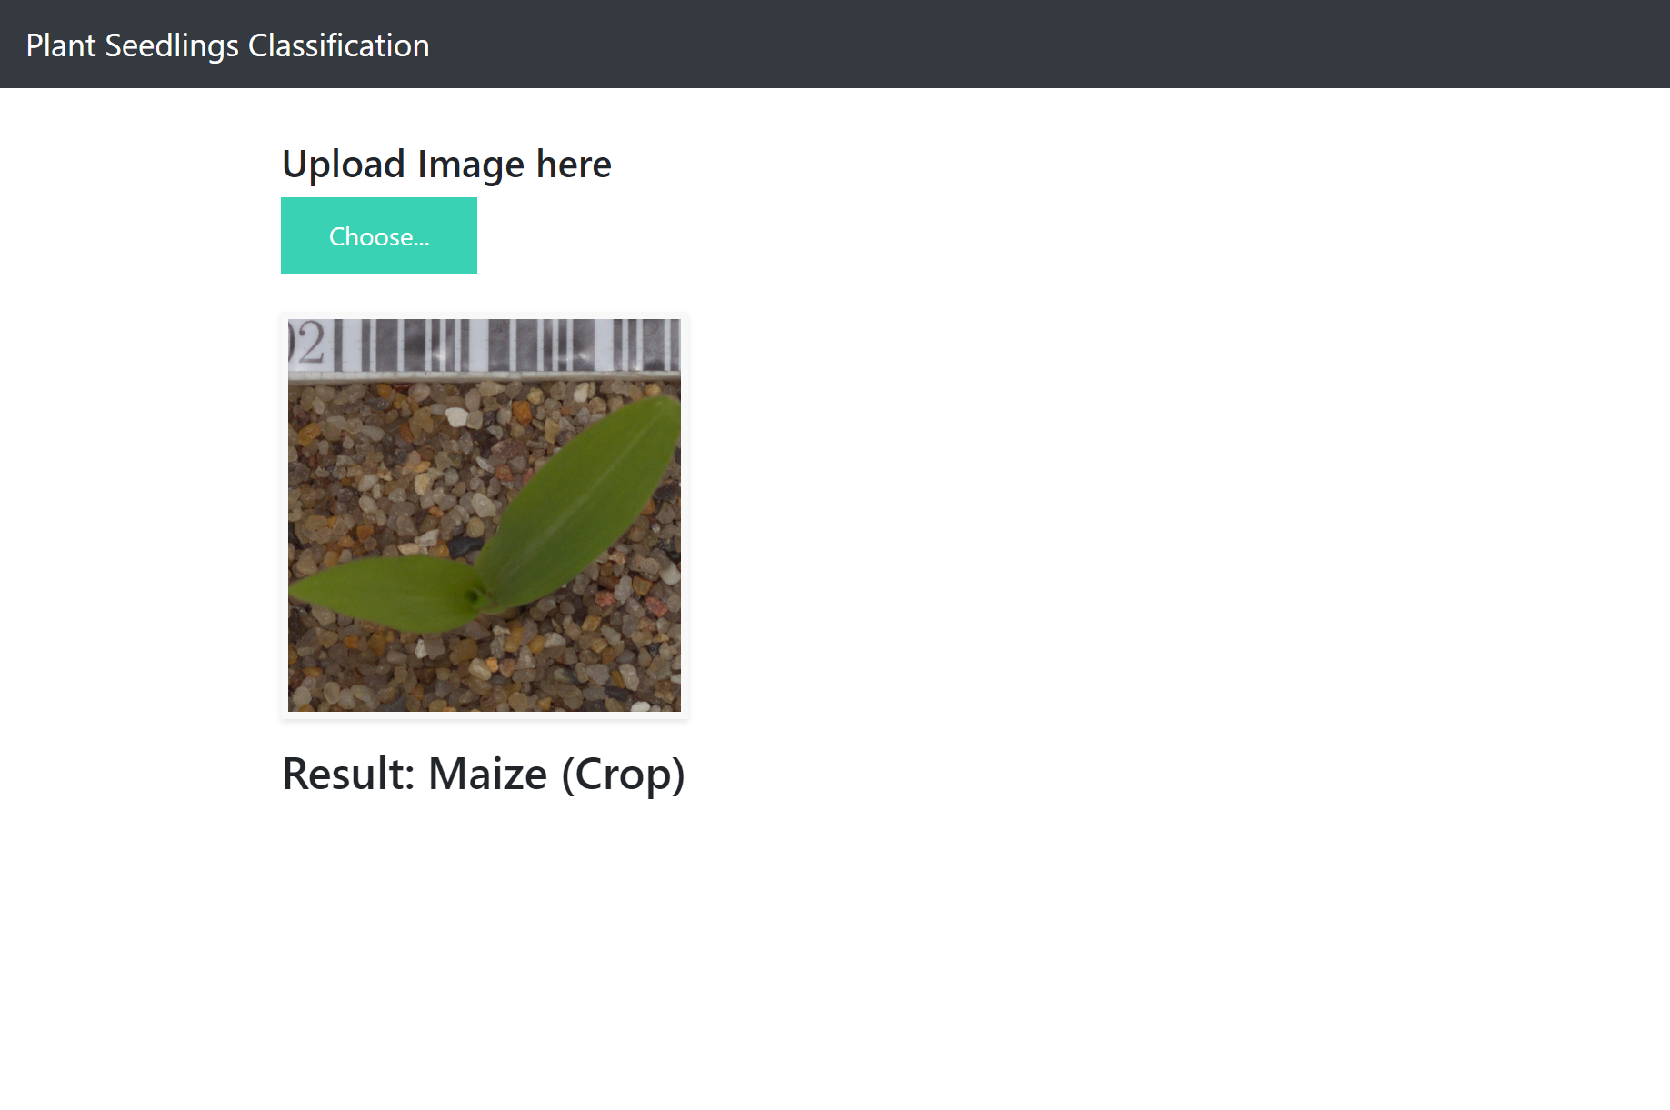
Output

Slide 35


